Slide 1
Python memory management & Impact to memory-hungry application
Kilik Kuo

Slide 2
Outline
About Photo-Organizing Software
What is it ? Who use it ?
Problems to developers
Brief to Python memory management
Thank God, we have Evan Jones & Nice guy Tim Peter
Possible solutions ?
For those which are handled in Python
For those can't be handled in Python

Slide 3





About Photo-Organizing Software

Slide 4

About Photo-Organizing Software

Slide 5

About Photo-Organizing Software

Slide 6



About Photo-Organizing Software
Problems that may kill the engineer !
Rapid UI flow experience
Full metadata display
Fancy UI transformation
Handle higher resolution
24 million (6000x4000) pixels
48 million (8000x6000) pixels
... WTF

Slide 7
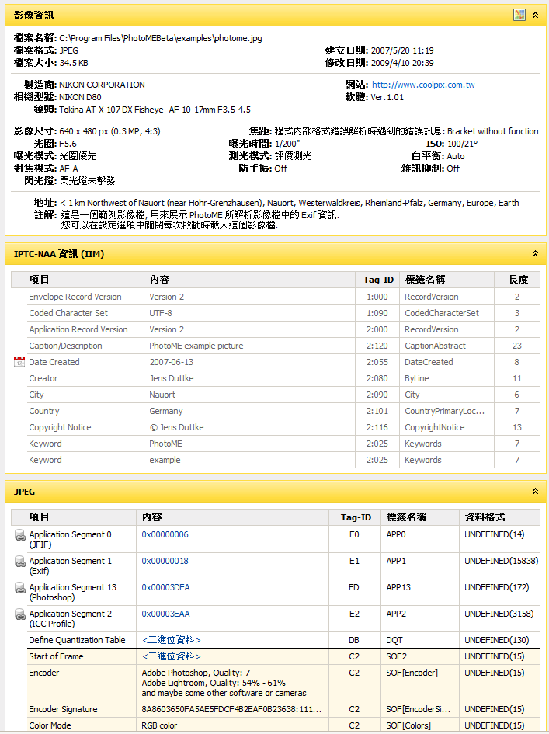
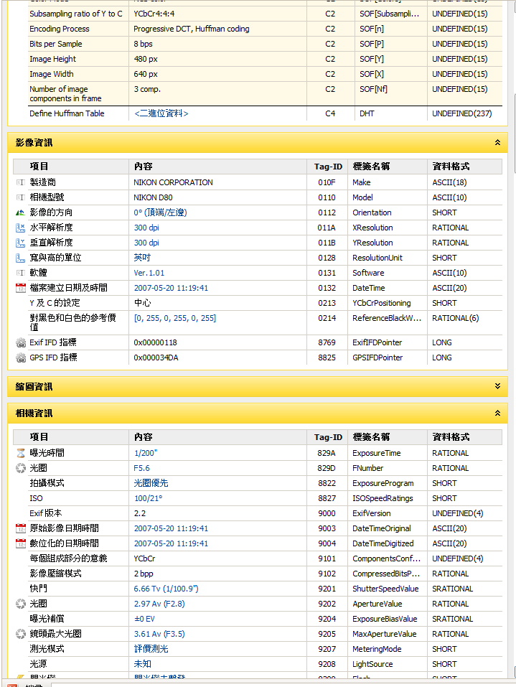
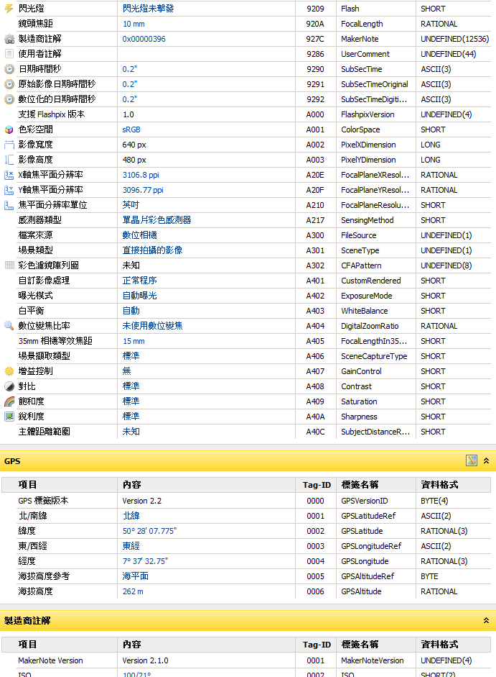
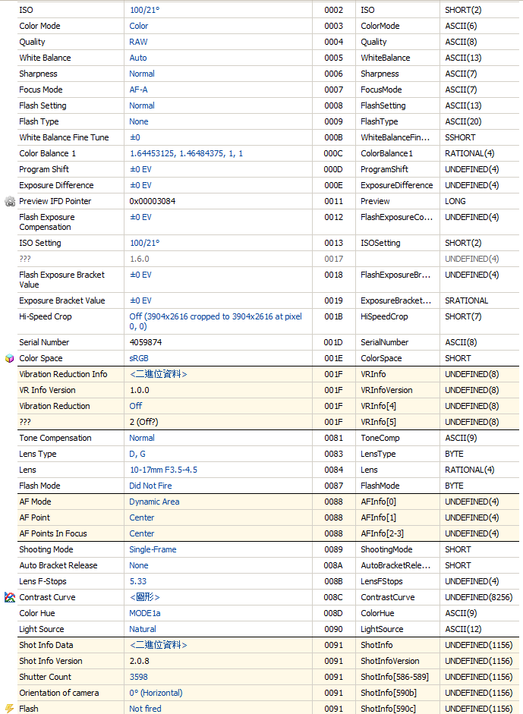
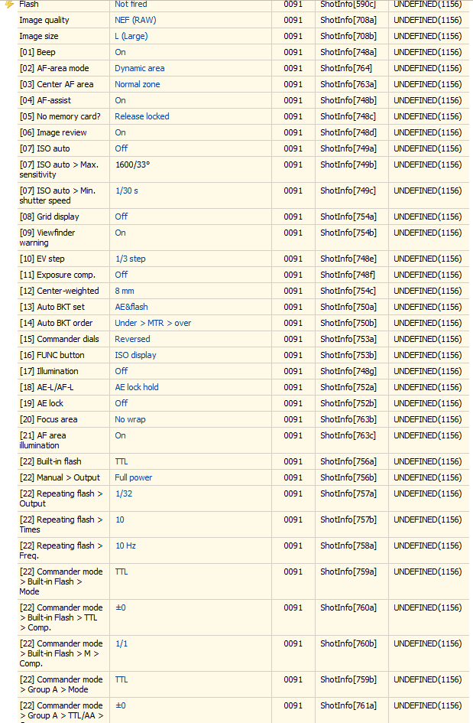
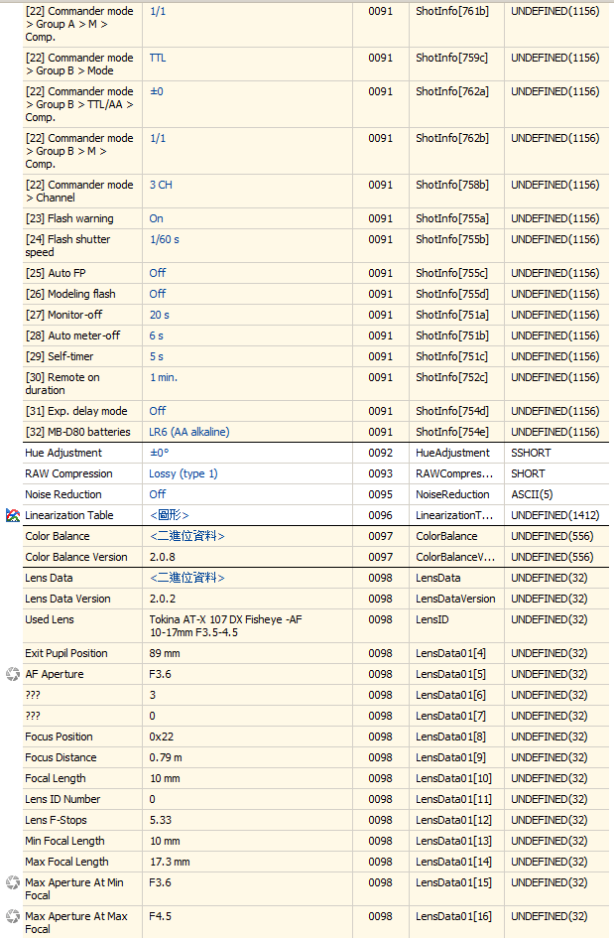
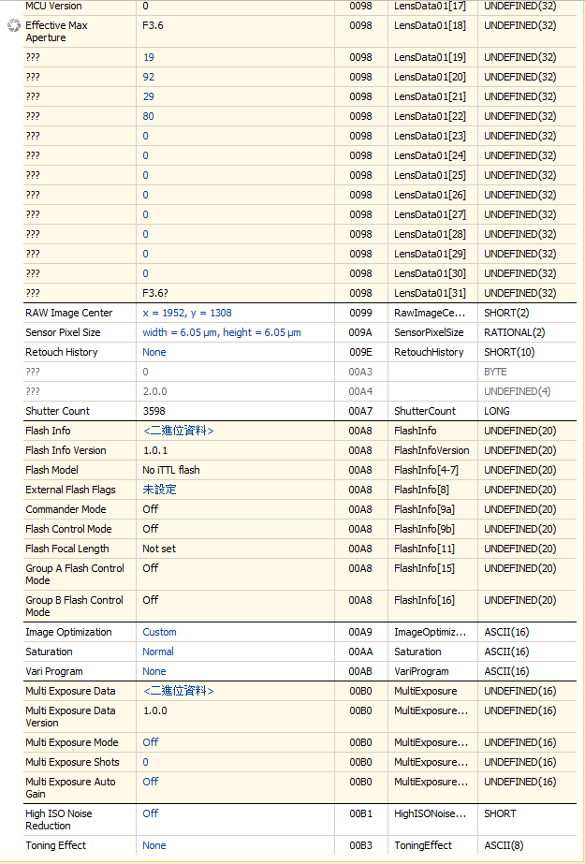
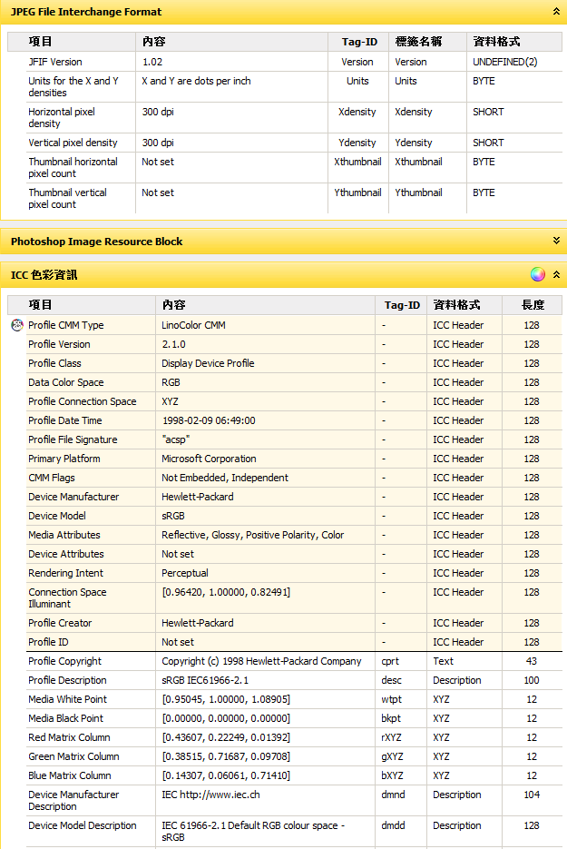
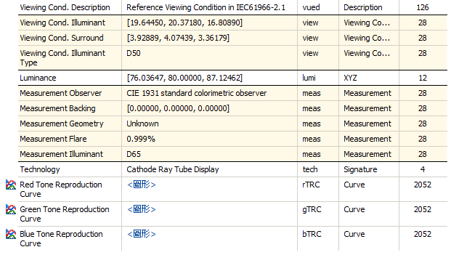
Metadata - EXIF/ IPTC/ XMP...

Slide 8
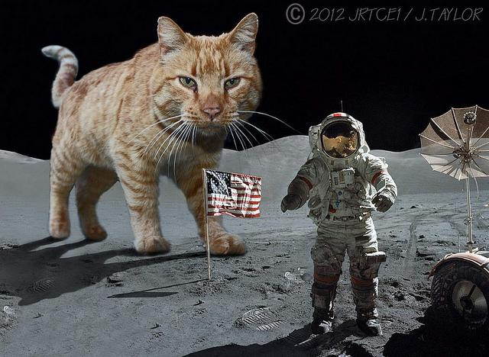
Houston, we've
got a Problem !!

Slide 9

Hungry for Memory Space !!!

Slide 10








Let's explore the SPACE
8000(W) x 6000(H) x 4(RGBA) x 2(BytePerChannel) = 366 MB
Space Start
Heap
Space End

Slide 11
Does it work on PhD ?
Continuous Memory Address is the KEY !!
1 BIG image should be ok, then 2, 3, 4, ... ?
On 32-bit OS
Limited to 2G user-mode virtual space
per process
Windows ASLR (Blue part - dll Image)
0x00000000 <-> 0x10000000
0x50000000 <-> 0x80000000
0x00000000 -->
You get almost 1G continuous memory space, until Python occupy the RED, and won't return to OS.
On 64-bit OS
8TB user-mode by default
Physical memory size is what you need to concern.
0x80000000

Slide 12


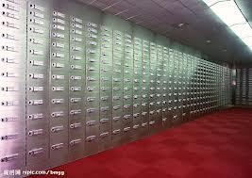
Python Memory Management
Imagine there's a PyBank, and you wanna get mortgage
Trick or Treat
......
$240, please ~
sure !

Slide 13
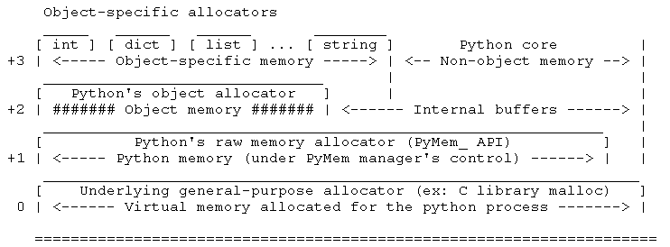
PMM - Allocator 四大天王
/trunk/Objects/obmalloc.c
PyObject_New/PyObject_Del

Slide 14
Inside the PyBank - PyObject Allocator
儲櫃
Free
26萬2144元
滿抽屜
4096元
262,144 / 4096
= 64
110
110
110
110
255
4096元
14
抽屜
14
14
錢袋
110
14
14
4096元
1

Slide 15
PyBank Money Management
蟒銀存款 : 21億4748萬3648元
小額放款部 (< 256 元)
大額放款部 (> 256 元)
取款步驟
告知銀行, 大額 or 小額 - 兜幾 ?
小額
檢查(放款儲櫃中的特定抽屜)裡找尋是否有剩餘符合的指定金額錢袋
有, 從剩餘的指定金額錢袋中拿一袋給你
沒有
從(錢最少但還有滿抽屜的儲櫃)中的滿抽屜裡拿出指定金額的錢袋
沒有儲櫃
開新的放款儲櫃, 從一個滿抽屜拿一袋指定金額錢袋給你
大額
拿去拿去拿去 ~
怎決定的 ？

Slide 16
儲櫃 Arena /抽屜 Pool /錢袋 Block
26萬2144元
A3
26萬2144元
A2
26萬2144元
A1
26萬2144元
A0
Free
Free
Free
23
13
255
144
43
64
14
110
2
8
110
7
5
3
1
Partially allocated Arena list
Free Pool(滿抽屜)
Free Pool(滿抽屜)
Free Pool(滿抽屜)
Free Pool
Free Pool
Free Pool
Free Pool
Free Pool
Free Pool
Pool(非滿抽屜) -
A2
Pool(非滿抽屜) -
A0
Pool(非滿抽屜) - A2
1 - 8 Byte
Used Pool list & Free Block list
2 - 16 Byte
5
1
2
5
1
2
1
2
249 - 256 Byte

Slide 17
Release the memory
All used Blocks(from Pool A) return to Pool A, and all used Pools(from Arena B) return to Arena B
Arena B is freed !
After Python 2.3 (Evan Jones & Nice guy Tim Peter)
Something still weird ...
int / float / tuple / list / dict doesn't act like above
gg...

Slide 18
Back to IMPACT - Solutions ?
What can we do ?
First, know where we are !
EXE
1. include "Python.h"
2. Load Python2X.dll
3. Py_Initialze()
4. Load script & DeMarshal it as PyCodeobject
5. PyEval_EvalCode(PyCodeObject)
Python Interpreter
1. int, float, list, tup, dict
2. PyObjects
3. Others
SWIG
1. malloc, new ...
2. Create PyObjects
3. Others

Slide 19
Inside Python World
For list/ dict objects
gc.collect() is able to release the maintained free list for list/ dict
Don't call it in the function where large list/dict items being created.
Use subprocess to hold these objects, and retrieve information through IPC.
Wrap the creation of these objects down to SWIG.

Slide 20
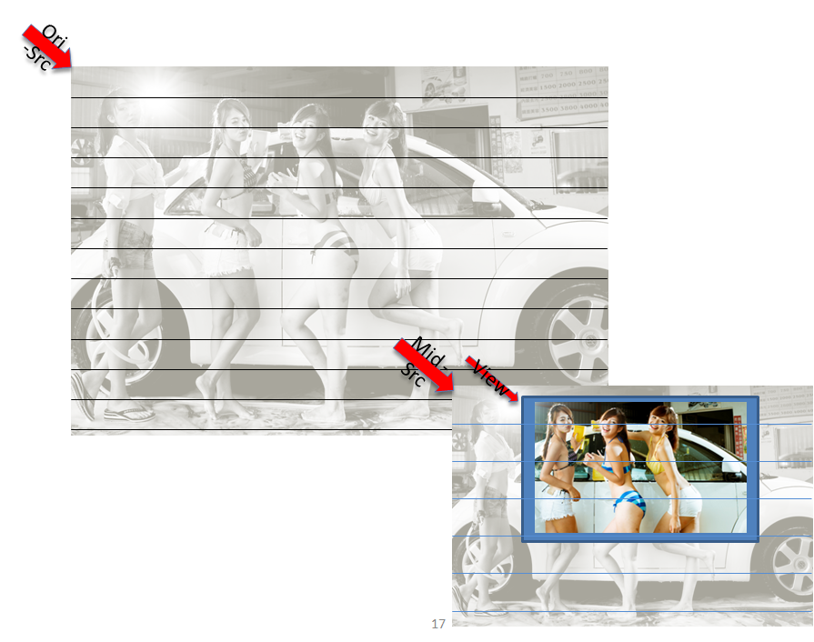
Outside Python World

Slide 21
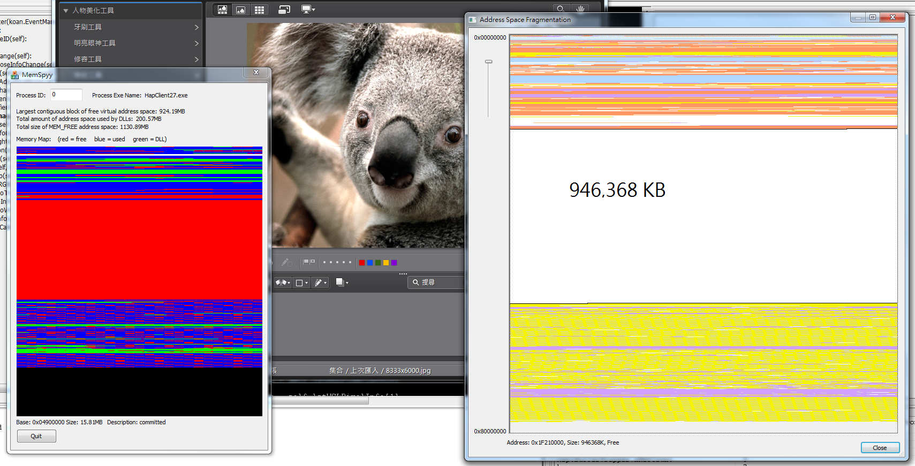
Outside Python World (Cont.)

Slide 22
Outside Python World (Cont.)
Divide image raw data into chunks
Re-write all related functions
Decode/ Stretch/ Encode/ Rotate
Pixel Operation, eg. BGRA <-> RGB.
Color Management
Retouch/Edit effect algorithm
族繁不及備載, 臨表涕泣, 不知所云...
Performance ?
SIMD
Multi-threaded (OpenMP)
Be aware of thread context switch overhead
GPU (OpenCL ?)

Slide 23
Conclusion
Be an open-minded engineer !!
You're more powerful than you think you are.

Slide 24
Q & A

